Slide 1

E-Commerce sales performance analysis
by Dimas Jabbar

Slide 2
TASK 1
Problem statement: We want to evaluate each of the marketing campaign to make the strategy to increase the revenue next period.
Metrics: Revenue value, number of transaction/order.
Goals: How to maximize the campaign strategy to increase the revenue next month
Assumption:
100% of sales contribute to Tinkerlust's revenue (since the data didn’t provide detail info about the revenue nett).
There are 2 source of the customers to shop in Tinkerlust:
Non - sales campaign: Organic, Direct. (we don’t consider this to the analysis, since it was not part of the campaign)
Sales campaign: Google ads, Facebook ads, Email, Referral, Others.
Business Questions:
How was the revenue earned from each campaign?
What kind of brand campaign that recommended to optimized in objectives to increase revenue next month?
What are the best regions to drive and promote campaign engagement?
Which voucher code works the best?
In the case below, explain your findings and recommendations systematically through Google Slides. The data shows sales information from February - April 2019 with additional information about sales sources.

Slide 3
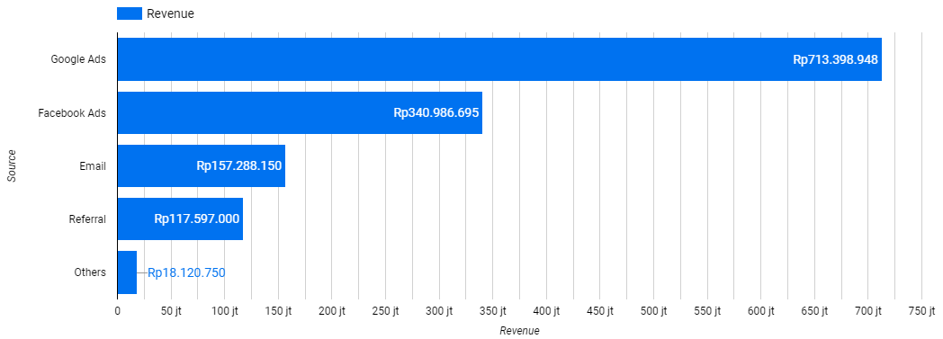
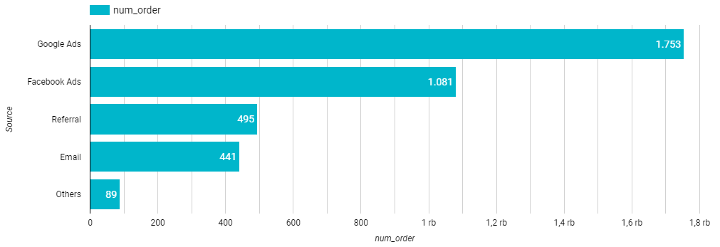
TASK 1
How was the revenue earned from each campaign?
Insights
Number of revenue per campaign
The best campaign performance based on the earned revenue and number of transactions since february-april 2019 was came from Google Ads and Facebook Ads.
Number of order /transaction per campaign

Slide 4
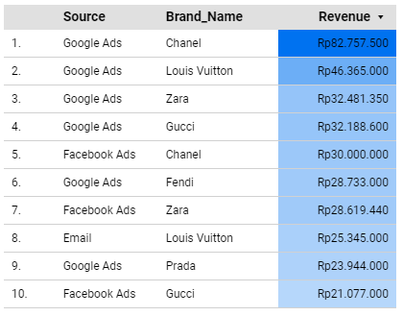
TASK 1
2. What kind of brand campaign that recommended to optimized in objectives to increase revenue next month?
Insights
Top 10 Number of revenue per campaign source per brand name items sold
Here are the Top 10 Earned revenue per campaign source by the sold item’s brand name.
From here, we can see the potential revenue income from this brand per campaign channel.

Slide 5
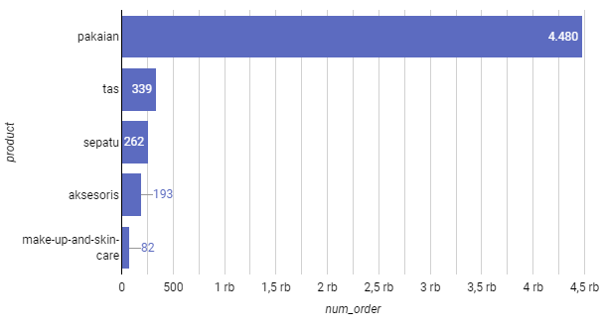
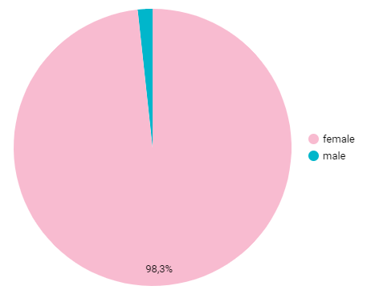
TASK 1
2. What kind of brand campaign that recommended to optimized in objectives to increase revenue next month?
Insights
Top 5 number of order per item’s category
Product’s gender sold items percentage
Continuing the previous analysis, from the top brand that successfully earned the biggest revenue. We can see that the most sold out items was came from “Pakaian”, followed by “tas”, “sepatu”, “aksesoris”, and “make up & skincare”.
98,3% of the sold out items was the female products.

Slide 6
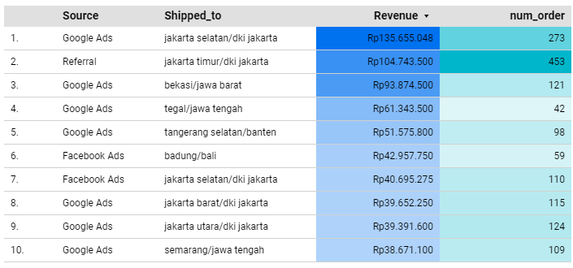
TASK 1
3. What are the best regions to drive and promote campaign engagement?
Insights
Top 10 Number of revenue and number of order per campaign source by their shipped region
Here are the Top 10 Earned revenue per campaign source by the shipped region. From here, we can see the potential revenue income from each customers region per campaign channel.
In addition, “Referral” campaign works well at Jakarta timur.

Slide 7
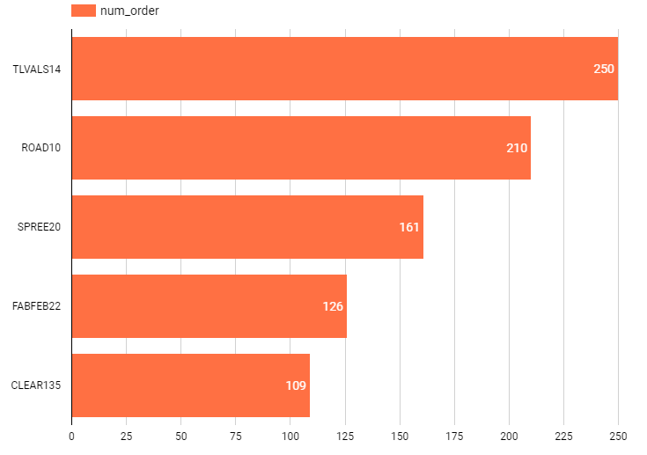
TASK 1
4. Which voucher code works the best?
Insights
Top 5 number of order per voucher code
Here are the Top 5 the biggest transaction/order number. From here, we can see the voucher code that works well.

Slide 8
TASK 1
Recommendations
Since the most profitable sold items was came from the Google Ads and Facebook Ads campaign, we suggest to maximize the these campaign to boost the revenue next month.
We recommend to consider, create the campaign to the specific brands and items category to boost the sale next month. So here, we suggest what kind of campaign to create next period:
Chanel, Louis Vuitton, Zara, Gucci, Fendi, and Prada campaign seems have the potential brand to increase the revenue next month.
Pakaian, tas, and sepatu would be nice for campaign theme items next month.
We suggest to boost the female items campaign since 98% of the beneficial items sold was the female items.
We suggest to re-target the campaign to the specific region. Based on the previous insights, we suggest to maximize the sales to the potential region (look at the previous insights), in line with each campaign types.
Since we can see the best voucher code that works well on the previous insights (TLVALS14, ROAD10, SPREE20, FABFEB22, CLEAR135), we suggest to optimize the campaign with the respective voucher code.

Slide 9
TASK 2
In the case below, explain your findings and recommendations systematically through Google Slides. The data shows campaigns performance with several metrics.
Notes : You can add other metrics based on available metrics
Problem statement: We want to evaluate each of the marketing campaign based on the provided data
Business Questions:
Which Campaign that earn the biggest revenue, also how was the cost?
Which Campaign that have the best performance (based on the average revenue nett per transactions)?
How many customers that made transactions from each campaign?
Campaign | Revenue | Cost | Transactions | New Customers | Retain Customers | Revenue nett (Revenue - cost) | Average Revenue nett / TRX
A | 678943500 | 29128000 | 2076 | 543 | 542 | 649815500 | 313013,2466
B | 348969000 | 13698900 | 1003 | 339 | 411 | 335270100 | 334267,2981
C | 764839000 | 38748700 | 1693 | 465 | 639 | 726090300 | 428877,909
D | 845249000 | 47800200 | 1452 | 689 | 718 | 797448800 | 549207,1625
Available metrics
Additional metrics

Slide 10
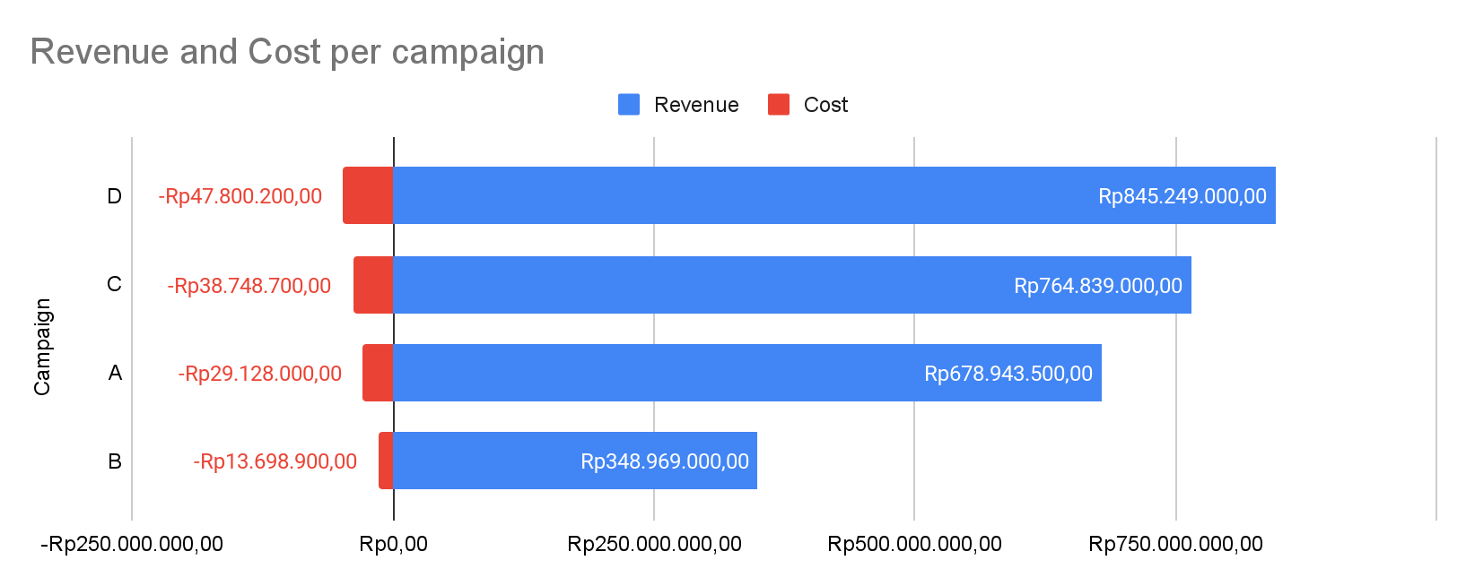
TASK 2
Which Campaign that earn the biggest revenue, also how was the cost?
Insights
The biggest revenue was earned from campaign D, followed by C, A, and B.
The biggest cost that required, to run the campaign was came from campaign D, followed by C, A, and B.
In this pattern, we can see that: more revenue needs more campaign cost.

Slide 11
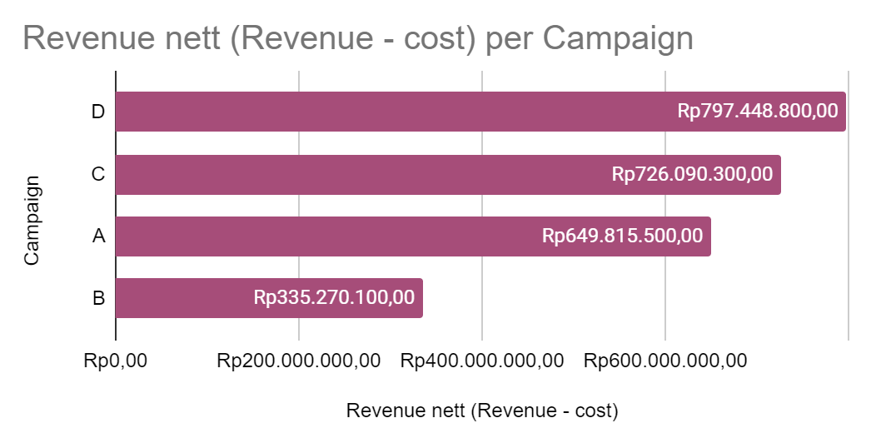
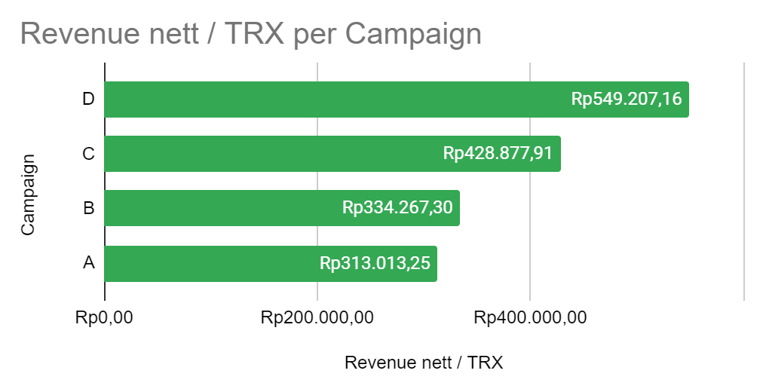
TASK 2
2. Which Campaign that have the best performance (based on the average revenue nett per transactions)?
Insights
The biggest revenue nett was earned from campaign D, followed by C, A, and B.
The campaign D and C have the best performance in terms of the revenue quality (revenue nett per transaction).
Compared between campaign A and B, we can see that the campaign A earned the bigger revenue nett value than campaign B. But, if we look at the transaction quality (average revenue per transaction), that the campaign B actually have more potential revenue rather than campaign A.

Slide 12
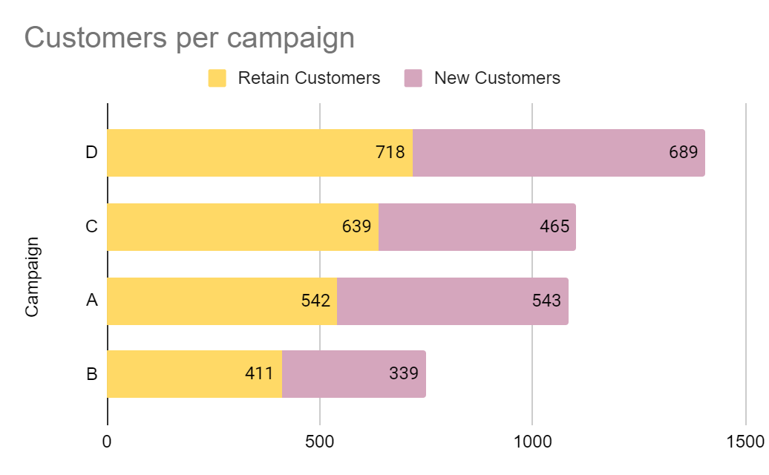
TASK 2
3. How many customers that made transactions from each campaign?
Insights
The Biggest number of customers that did the transaction was came from campaign D, followed by C, A, and B.
Campaign D have the best performance in terms of customers retention and also have a better performance to engage new customers.

Slide 13
TASK 2
Recommendations
Based on their higher revenue (revenue nett & average revenue per transaction), and customer retention. We suggest the marketing team to allocate more budget to Campaigns D and C to increase the revenue on the next month. Even Though, campaigns D & C have the biggest cost, but the campaign was worth it to consider to being maximize.
Consider improving Campaign B (it actually potential, since it has better average revenue/trx rather than campaign A) to improve the number of transactions and new customers. If it doesn't improve on the next month, consider re-allocating resources.

Slide 14
TASK 3
Please write SQL statements to answer the following questions;
1. Count the number of completed items per day.
SELECT
date_trunc(Order_Created, day) as day,
COUNT(Order_Item_ID) as number_of_items
FROM `tinkerlust-test.tinker.order` a
LEFT JOIN `tinkerlust-test.tinker.order_item_id` b
ON a.Order_ID = b.Order_ID
LEFT JOIN `tinkerlust-test.tinker.status_order_item` c
ON b.Status_ID = c.Status_ID
WHERE c.status = 'Completed'
GROUP BY 1

Slide 15
TASK 3
Please write SQL statements to answer the following questions;
2. Find the percentage of customers who made more than one completed order.
with base as (
SELECT
Customer_ID,
COUNT (DISTINCT a.Order_ID) as number_completed_order
FROM `tinkerlust-test.tinker.order` a
LEFT JOIN `tinkerlust-test.tinker.order_item_id` b
ON a.Order_ID = b.Order_ID
LEFT JOIN `tinkerlust-test.tinker.status_order_item` c
ON b.Status_ID = c.Status_ID
WHERE c.status = 'Completed'
GROUP BY 1
HAVING number_completed_order > 1
),
cust_num_complete_order as (
select count(Customer_ID) as num_cust_completed
from base
),
total_cust as (
SELECT
count(distinct Customer_ID) as num_total_cust
FROM `tinkerlust-test.tinker.order`
)
select
num_cust_completed,
num_total_cust,
(num_cust_completed/num_total_cust)*100 as percentage
from cust_num_complete_order, total_cust

Slide 16
THANK YOU
Here is the dashboard link (in google data studio)
https://lookerstudio.google.com/reporting/759514fe-e487-4a50-b0d7-2ee6ea69fb58

